Slide 1



OpenSense Training School OS-based nowcasting with pysteps
Wrap up and closure
Training instructors:
Jenna Ritvanen (Finnish Meteorological Institute) and Ruben Imhoff (Deltares)

Slide 2
What we have learned today

Slide 3
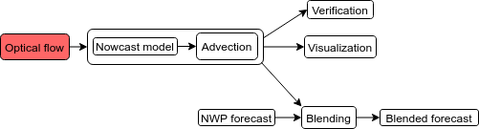
Reading data with pysteps and a full nowcasting workflow

Slide 4
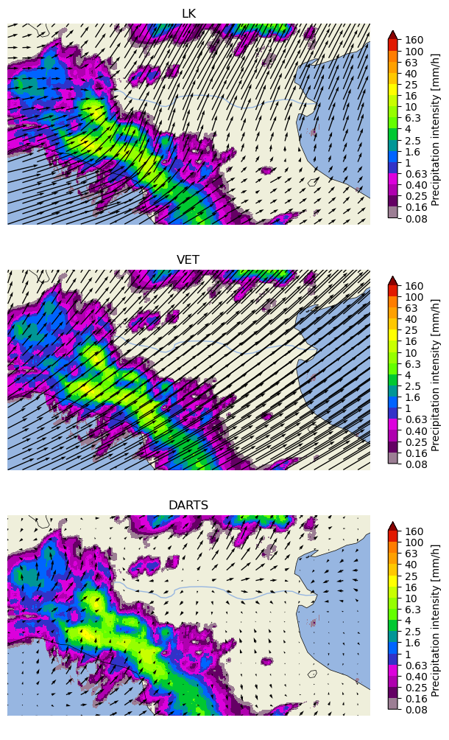
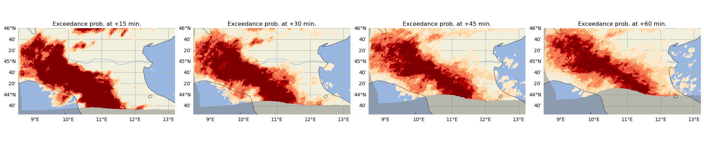
Reading data with pysteps and a full nowcasting workflow

Slide 5
Your experience
Was it easy/hard?
Do you think you could make a nowcast yourself now with your own data?
How did the different nowcasts (methods) compare?
What was the quality of the nowcasts with the different OS product?
Further questions?

Slide 6
Challenges when using OS data compared to conventional radar data

Slide 7
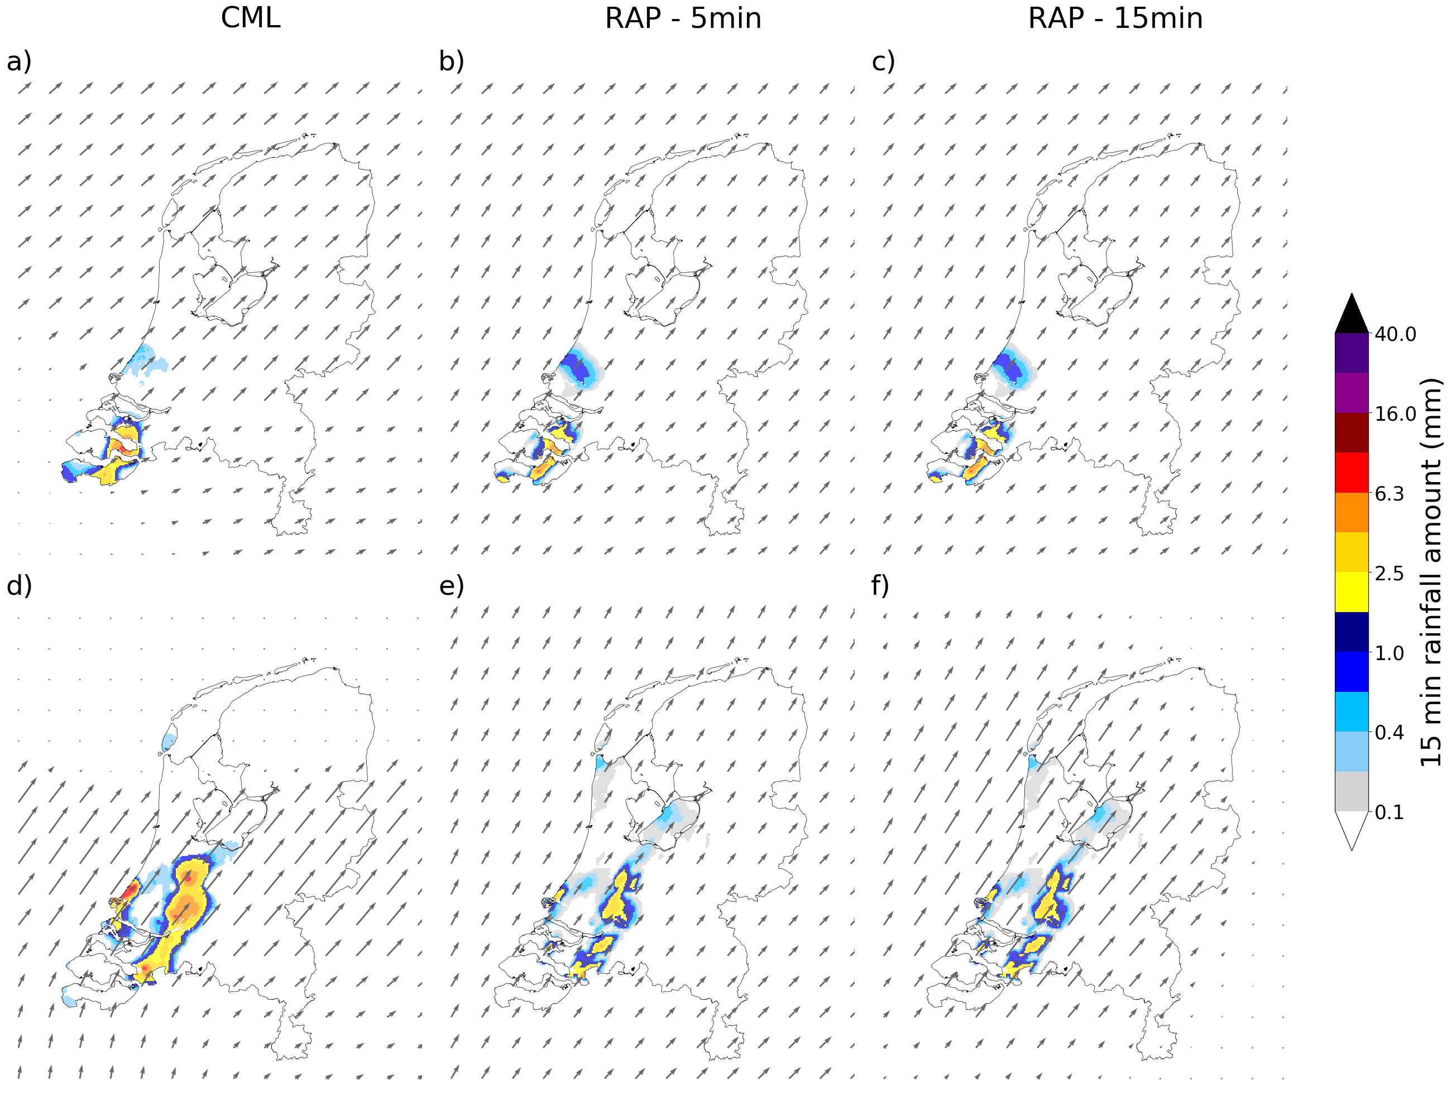
Challenges when nowcasting with OS data
Advection field derivation
Data consistency
What challenges did you come across?
Can we directly go for nowcasting with OS data?
How to improve it?
CML
Radar (5 min.)
Radar (15 min.)
Imhoff et al., GRL, 2020

Slide 8
What more is possible with pysteps?

Slide 9
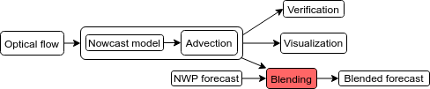
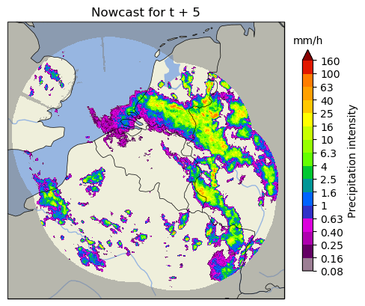
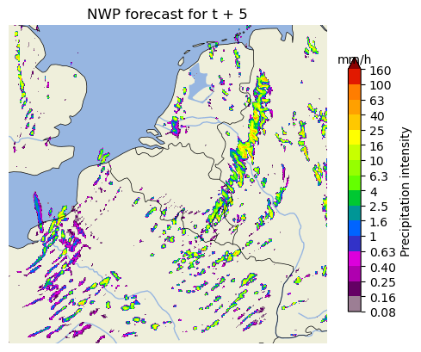
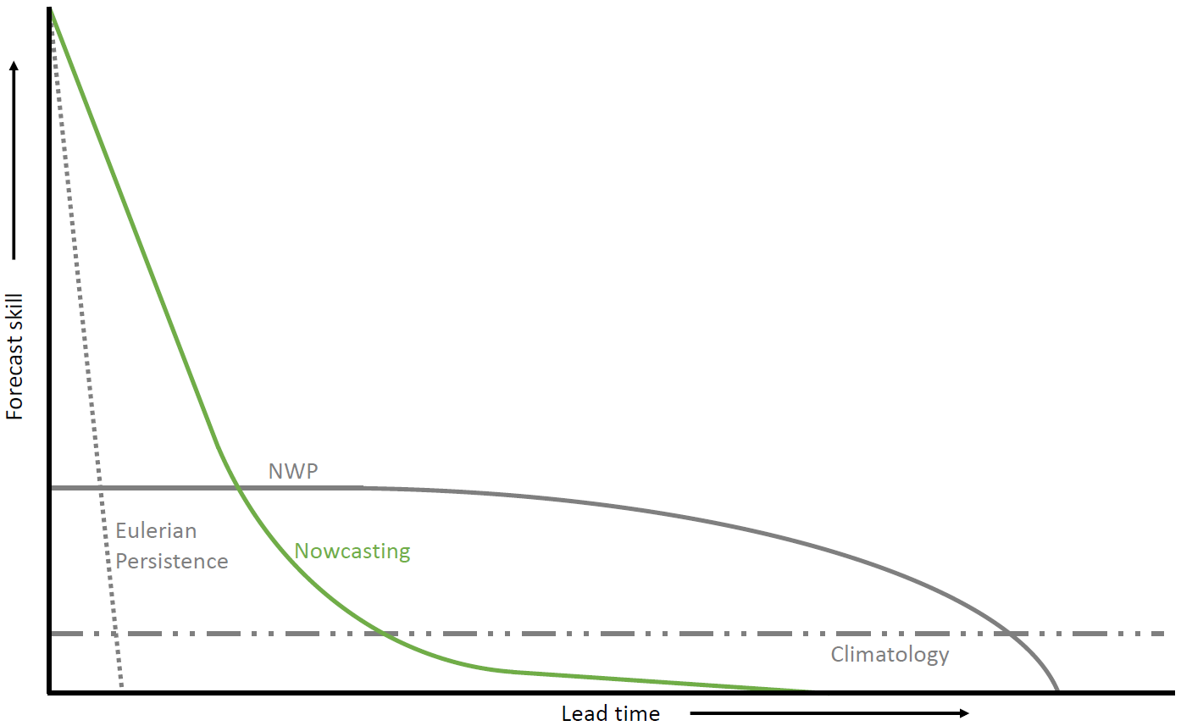
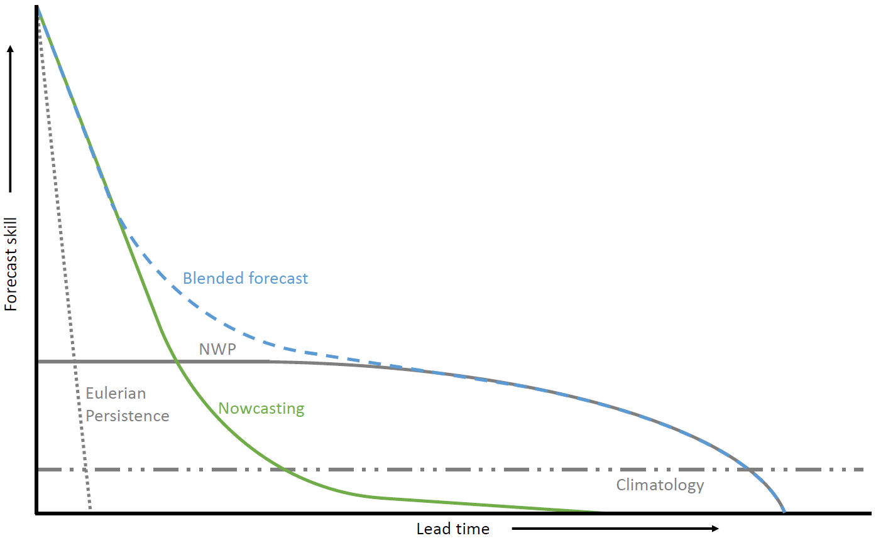
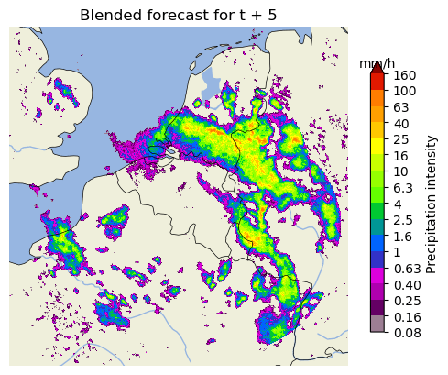
Blending with NWP
Nowcasting more skillful than NWP up to approx. 2 h. Often not enough for (flood) early warning.
How to improve the rainfall forecast up to 6 h or more ahead?

Slide 10
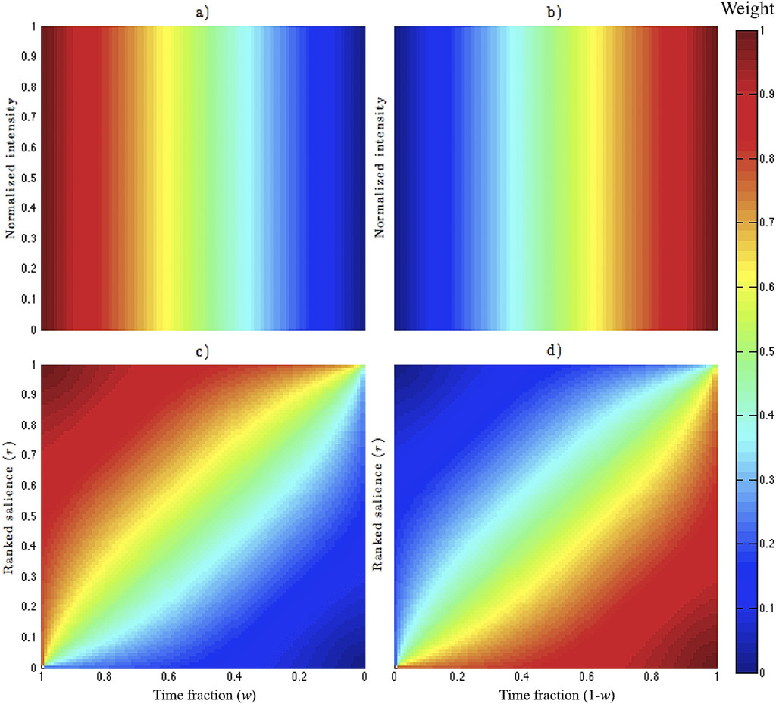
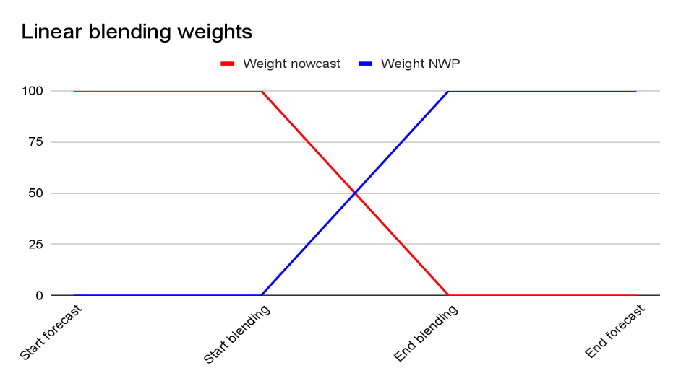
Blending with NWP: methods in pysteps
1. Linear blending
Fixed start and end point of blending procedure
Weights go linearly from 1 to 0 and 0 to 1.
2. Saliency-based blending
Similar to linear blending, but:
Preserves pixel intensities over time if they are strong enough according to their ranked salience.
3. STEPS blending (see next slide)
Hwang et al., 2015, Weather and Forecasting

Slide 11
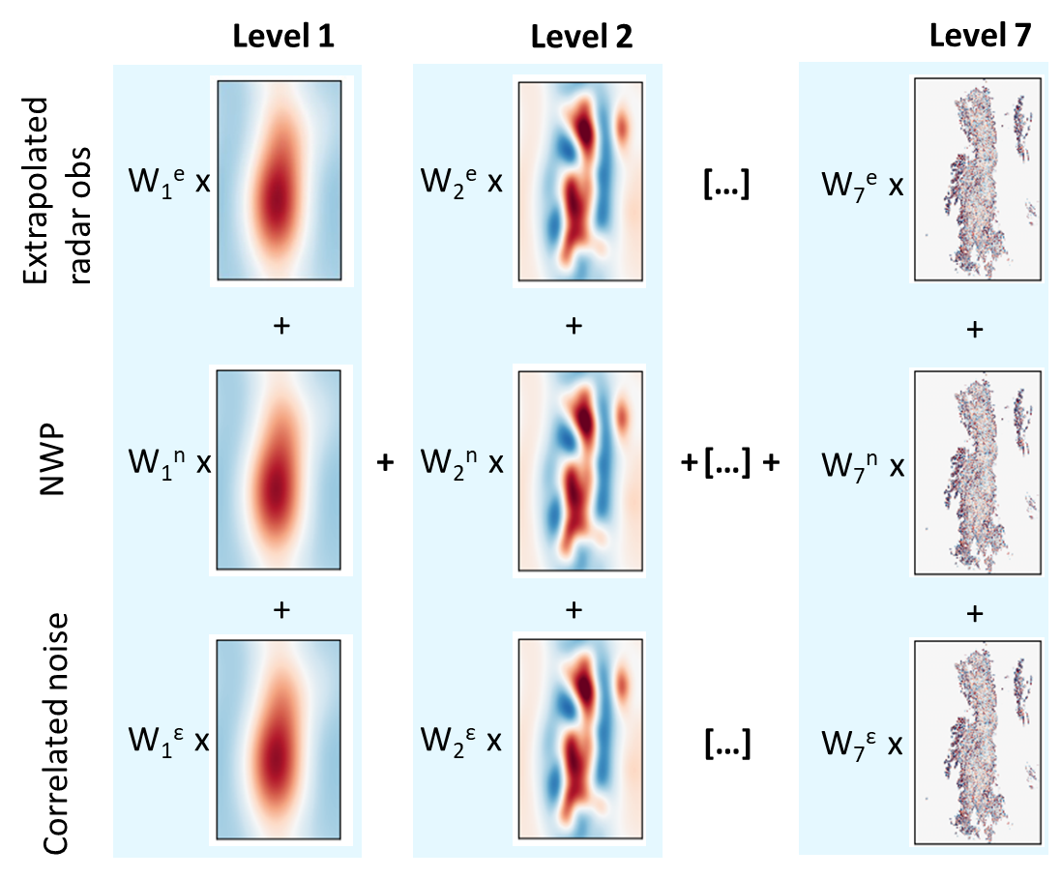
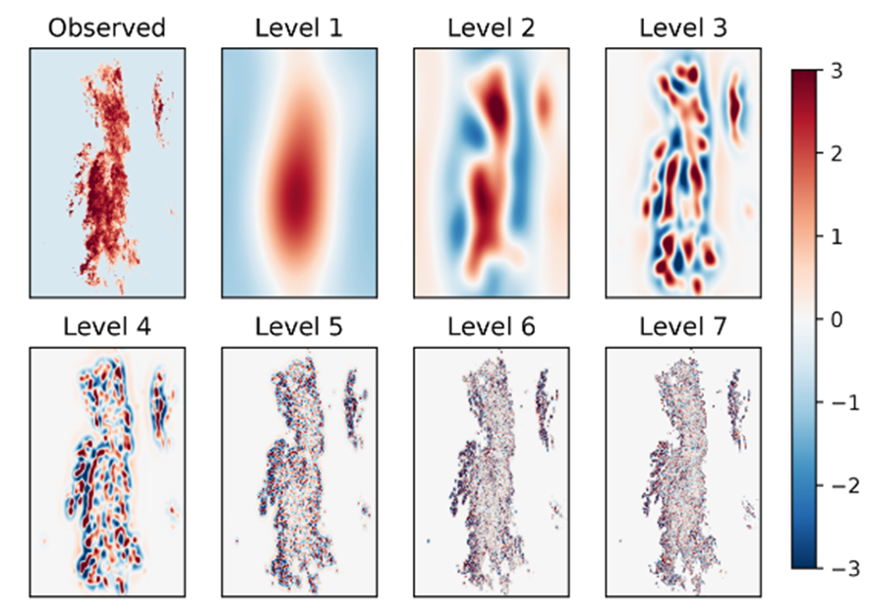
The STEPS method
Per ensemble member:
Pulkkinen et al., 2019
Blending weights depend on initial and expected future skill

Slide 12
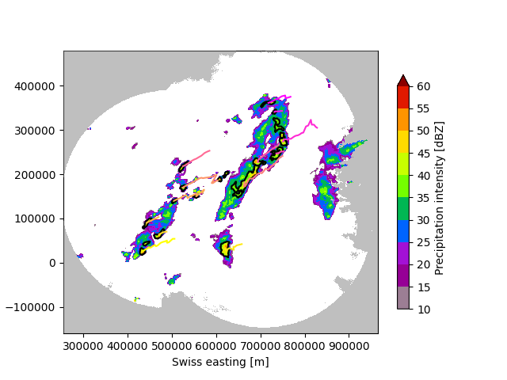
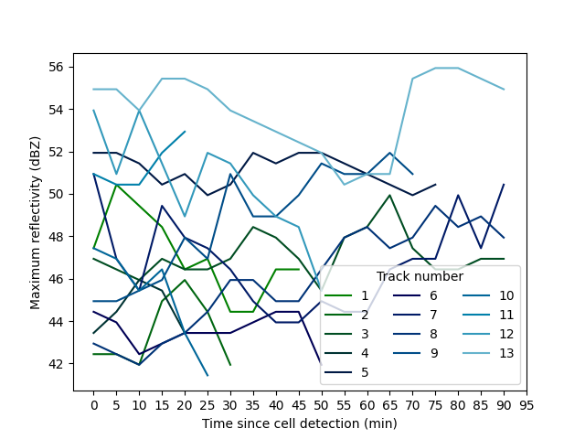
T-DaTing module: Thunderstorm
Detection and Tracking
Identify and track thunderstorm cells from radar images
Visualize cells and tracks in time
Study properties of the cell tracks
Tracking algorithm from the Swiss TRT Thunderstorms Radar Tracking algorithm
Hering et al., 2004, ERAD 2004
Feldmann et al., 2021, Weather Clim. Dynam
For how to use, see the example in the gallery

Slide 13
Benchmarking other methods
From the documentation:
When selecting correct method to benchmark against e.g. machine learning models, consider what do you want to achieve with the model
preserve variance
minimize error
represent uncertainty?
To get comparable forecasts, use methods that try to achieve similar objectives
For a more detailed discussion, see the documentation
Nowcast type | Machine learning | pysteps | Verification
Deterministic (variance-preserving) | SRGAN, Others? | pysteps.nowcasts.extrapolation (any optical flow method) | MSE, RMSE, MAE, ETS, etc
Deterministic (error-minimization) | Classical ANNs, (deep) CNNs, random forests, AdaBoost, etc | pysteps.nowcasts.sprog, pysteps.nowcasts.anvil or ensemble mean of pysteps.nowcasts.steps/linda | MSE, RMSE, MAE, ETS, etc or better normalized scores, etc
Probabilistic (quantile-based) | Quantile ANN, quantile random forests, quantile regression | pysteps.nowcasts.lagrangian_probability or probabilities derived from pysteps.nowcasts.steps/linda | Reliability diagram (predicted vs observed quantile), probability integral transform (PIT) histogram
Probabilistic (ensemble-based) | GANs, VAEs, etc | Ensemble and probabilities derived from pysteps.nowcasts.steps/linda | Probabilistic verification: reliability diagrams, continuous ranked probability scores (CRPS), etc. Ensemble verification: rank histograms, spread-error relationships, etc

Slide 14
Thank you!
Jenna Ritvanen (Finnish Meteorological Institute) and Ruben Imhoff (Deltares)

